Slide 1
Data Visualization and Communication
An Analysis of Suicide Trends in Greece
Lakkas Ioannis
https://drive.google.com/drive/u/0/folders/1HiYKlgQimoK-Whac75dkcg_lv1HRUJa0

Slide 2
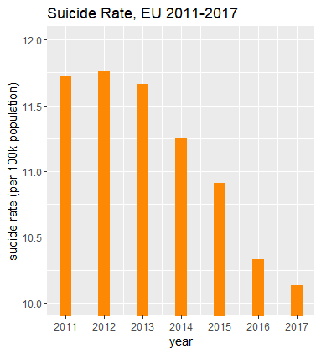
Suicide Trend in Europe
During 2011-2013 the suicide trends remained almost stable .
The highest peak of 11.76 in 100k people was observed in 2012.
The next years, there was a decline in the rates of suicides.
Τhe lowest value(10.13) was observed in 2017.

Slide 3
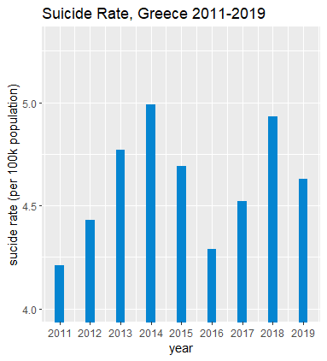
Suicide Trend in Greece
In comparison to EU, there is an increasing trend in suicides in Greece
From the 2011 to 2014 there was an increase of 18.52% in suicides over 100.000 inhabitants.
The highest peak is observed in 2014 with a value 4.99 (per 100k people)
Between 2015-2016 the rate of suicides was decreased
In 2018 there was the second highest rate (4.93) of suicides among the years 2011-2019

Slide 4
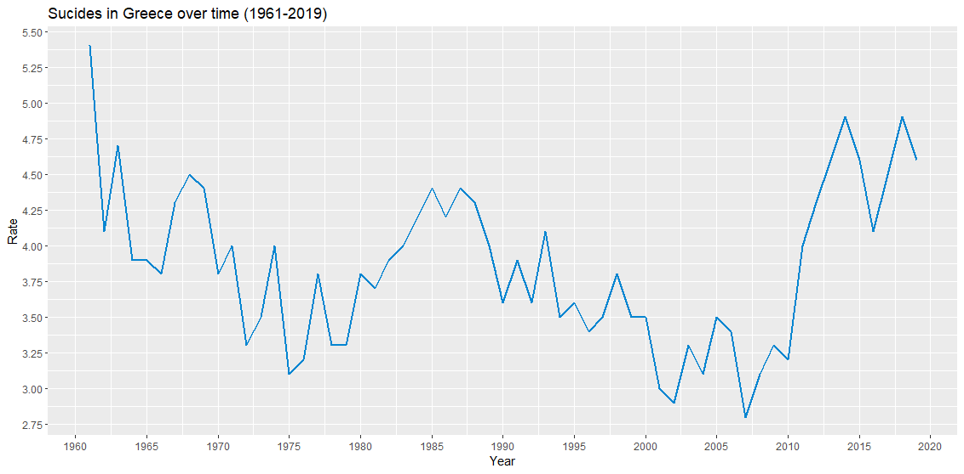
Suicide Trend in Greece
Among the years 1961-2010 the suicide rates varied but without big increases/ declines.
After 2010, the increase in the suicide mortality rates is huge for Greece.
Between 2010-2014 this increase was 53.1%.
This increase, and the high values of the following years, have been attributed by many people to the economic crisis that started in late 2009 and plagues Greece until today.

Slide 5
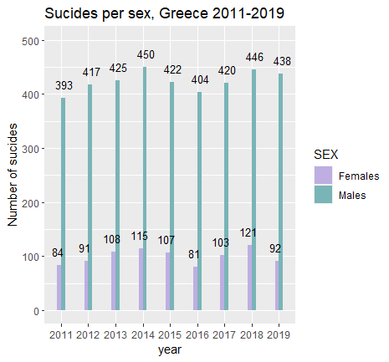
Suicide Trend in Greece
Among these years, the number of males that suicide is approximately 4 times higher than the number of females
The highest number of males’ suicides was observed in 2014.
While the highest one for women was observed in 2018.

Slide 6
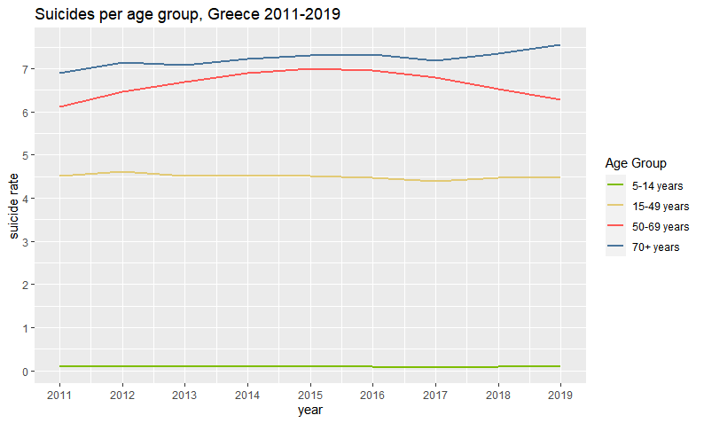
Suicide Trend in Greece
The more suicides were observed in the 70+ years age group.
Then follows the 50-69 group with the second highest number of committed suicides.

Slide 7
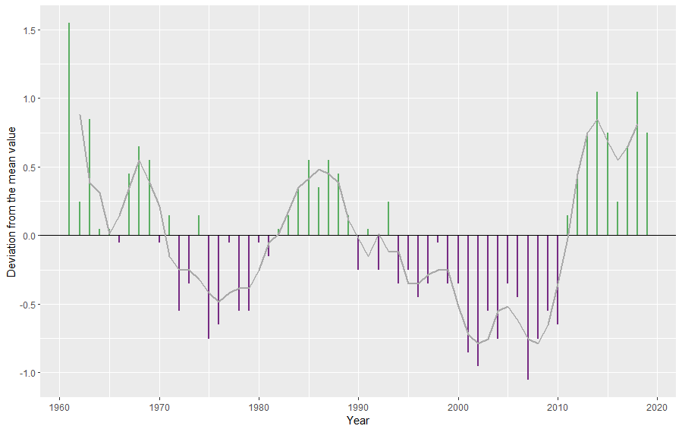
Suicide Trend in Greece
It can be observed that in Greece after 2010, there is an increasing deviation from the mean suicide rate.
The grey line, is the rolling 3-year average of this deviation.

Slide 8
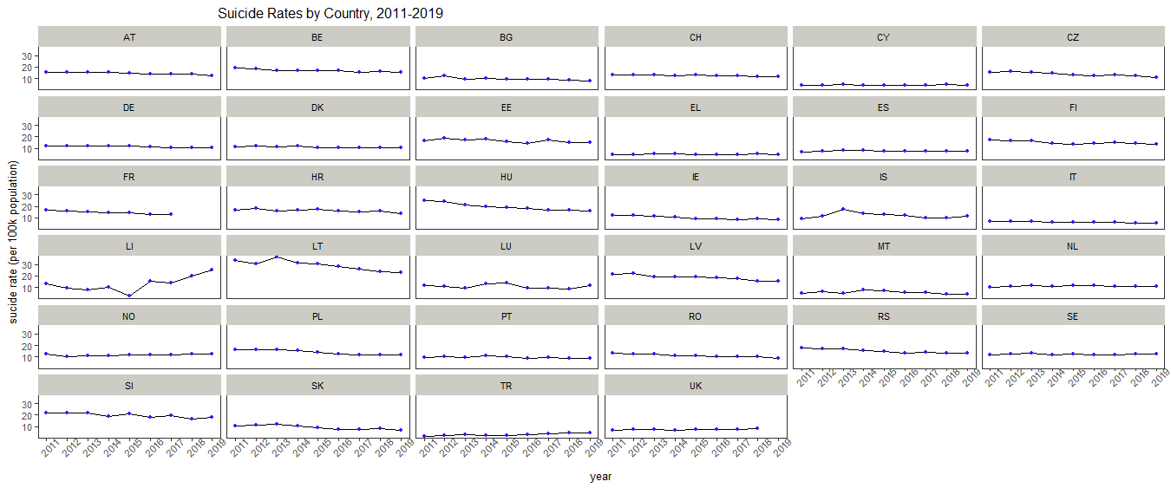
Suicide Trends in Europe by Country and Year

Slide 9
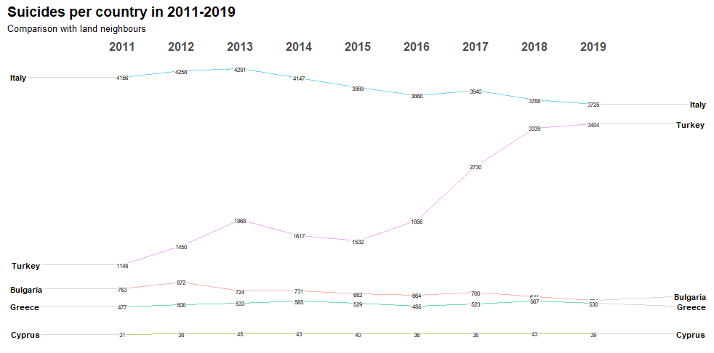
Greece Vs Neighbour Countries
The highest number of suicides among these countries was observed in Italy.
In Turkey, there was an apparent increase after the year 2016.
The total numbers of committed suicides of Greece and Bulgaria are very close during these years.
Among these countries, Greece has the second lowest total number of suicides, after Cyprus.

Slide 10
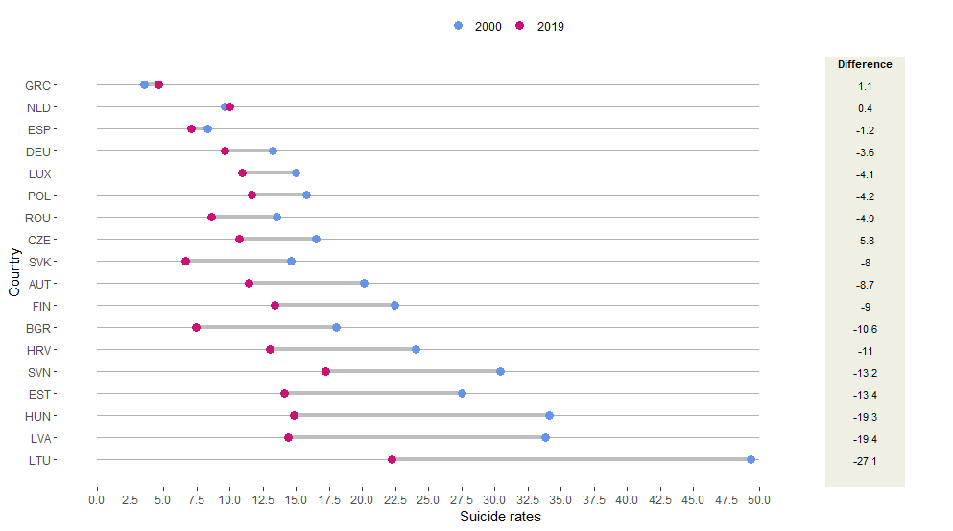
Change in suicide rates between 2000-2019 in EU
The line between the two bullet points depicts the difference. The longer the line, the bigger the difference in absolute value.
From the beginning of the millennium until 2019, we observe that Greece has the highest difference (1.1) in comparison with the other countries.

Slide 11
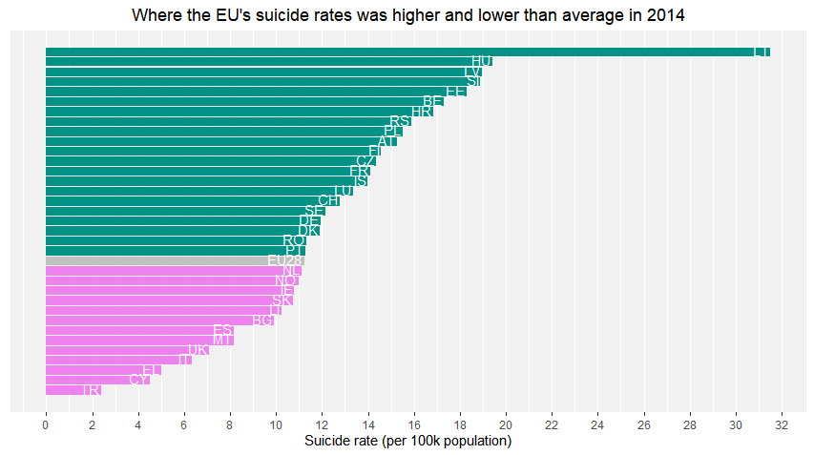
Suicide rates among EU countries in 2014
The year 2014, was selected because then Greece had the highest suicide rate during the period 2011-2019.
It can be observed that Greece even in its high peak, is the 3rd lowest rate among the other EU countries.

Slide 12
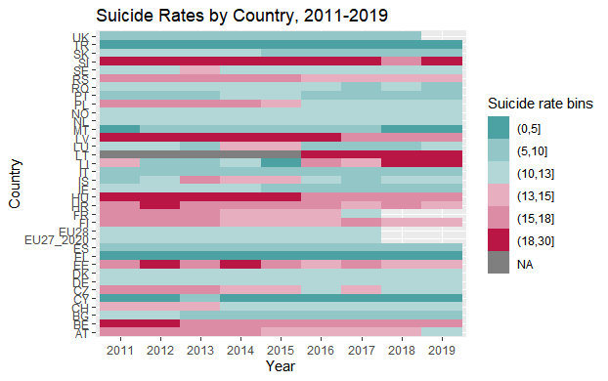
Suicide Trends in EU – Heatmap
It can be observed that Greece among these years the suicide rates remained stable and in low levels.
Actually, its rates are under the value of 5.
Greek suicide rates are among the lowest in the EU, a fact that is attributed to the mentality of the Greek society and the climate of the country.

Slide 13
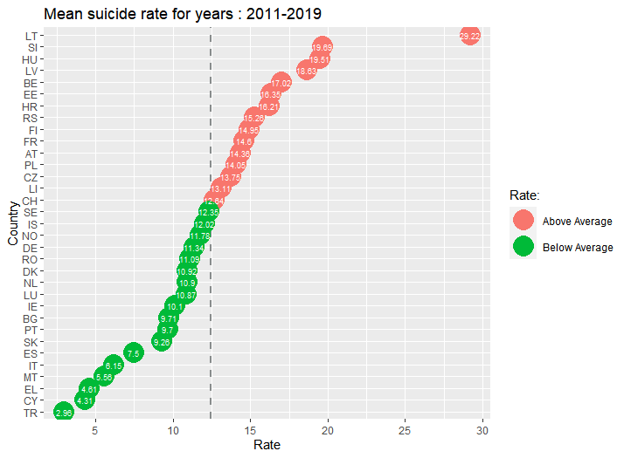
Average Suicide Rates, 2011-2019 in EU
Greece belongs to the group of countries that have average suicide rates below the EU’s one.
Greece’s rate(4.61) is almost three times lower than EU’s average(12.43)
In this plot, it is obvious that Greece has the third lowest average, for this time span.

Slide 14
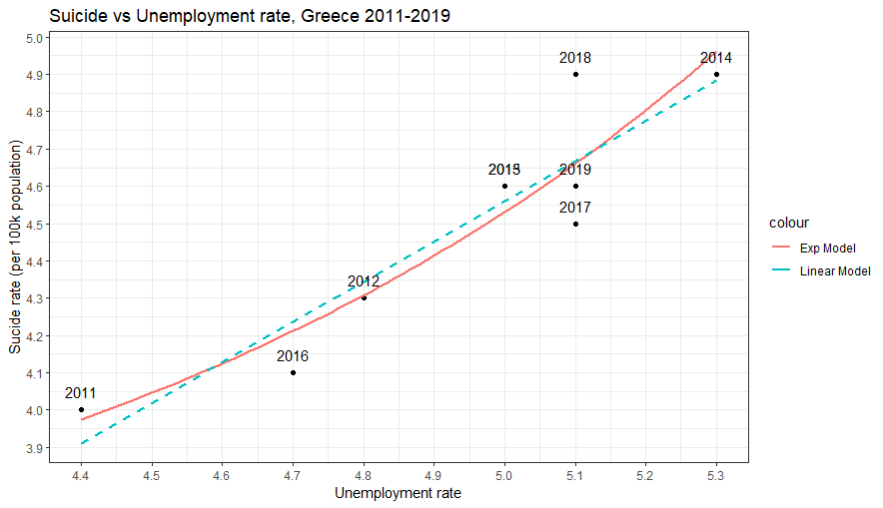
Suicide VS Unemployment in Greece, 2011-2019
As it was stated above the Greek suicide rates seem to be affected by the economic crisis, during these years.
One of the most important outcomes of this crisis, is the high rise in unemployment.
Unemployment is defined as the percentage of unemployed people divided by the population in the labour force for the age group of 20-64 years.
In this plot, it can be supported that there is a correlation between suicide rate and unemployment.

Slide 15
Συνοδευτικά Αρχεία
Τα συνοδευτικά αρχεία(data, r code, tableau notebook) βρίσκονται εδώ (https://drive.google.com/drive/u/0/folders/1HiYKlgQimoK-Whac75dkcg_lv1HRUJa0)
Για την εκτελεσή τους απαιτείται αλλαγή στα paths.

